Slide 1
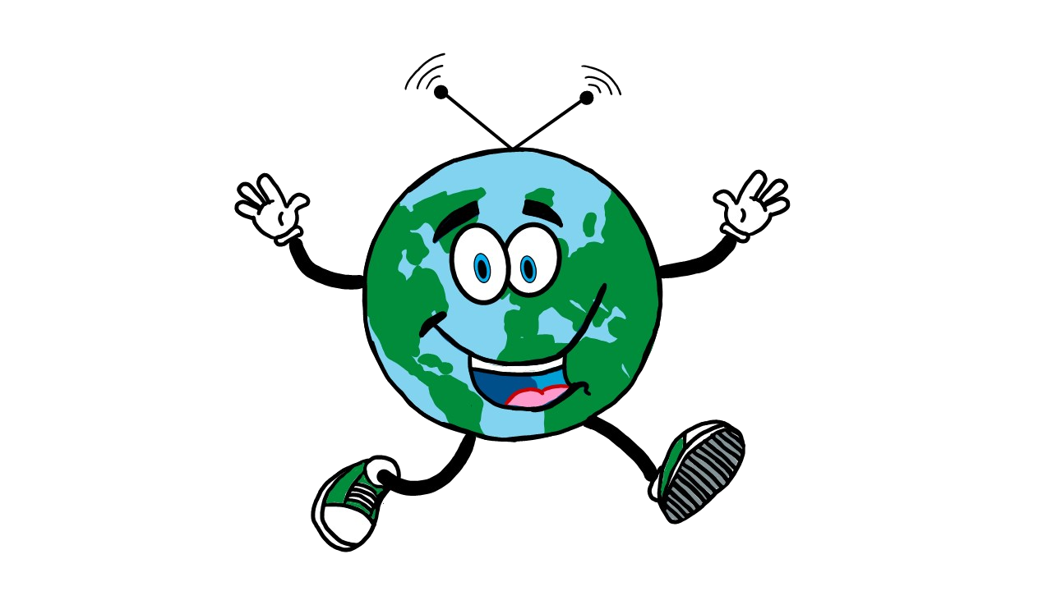
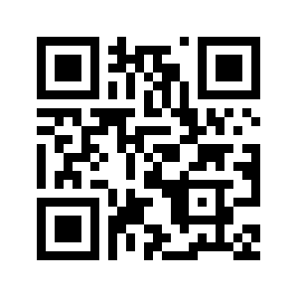
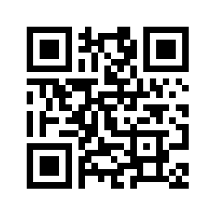
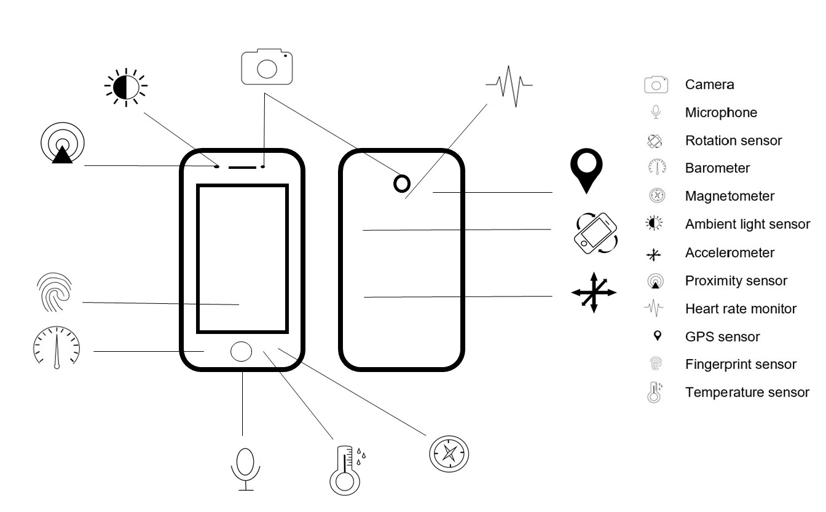
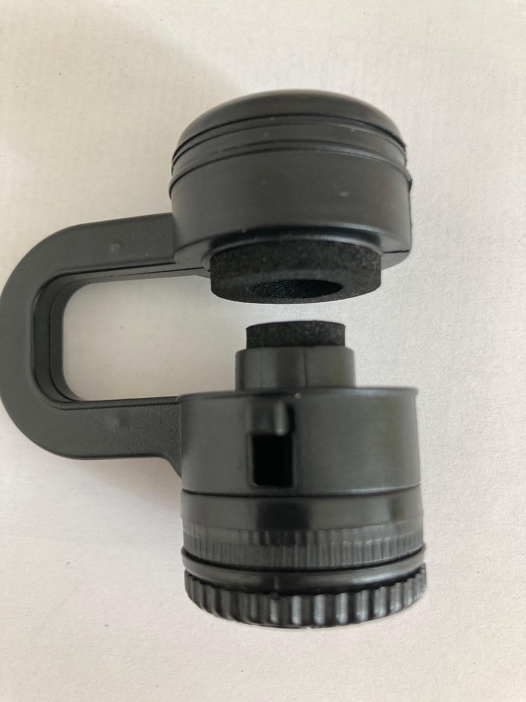
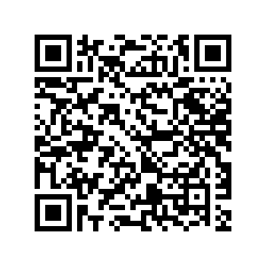
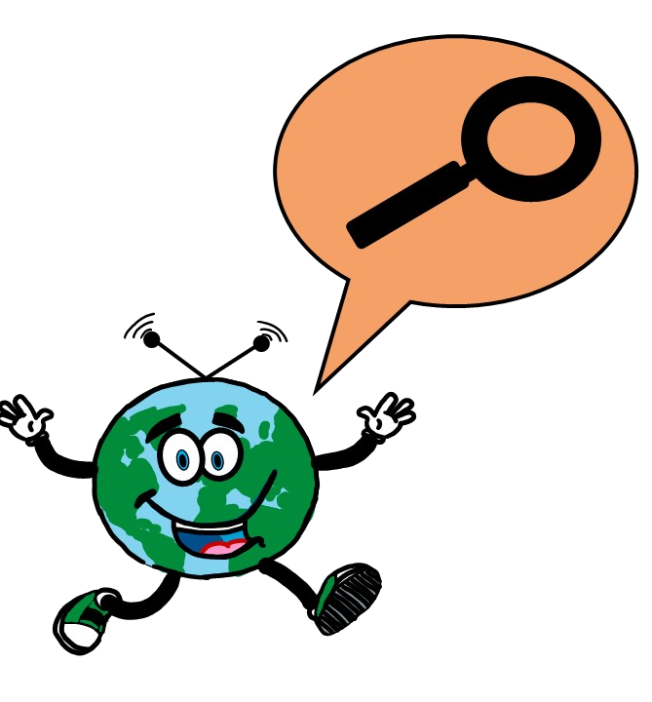
Explore the environment with your smartphone
Intro
Technologies have always been developed to better understand the living world and the phenomena of nature. Think of a compass, a ruler, a pair of scales, etc. On the one hand, digital technologies help us to understand the world better. On the other hand, they represent the world in a specific way and cannot represent another. Here you will find a guide to exploring this.
Required Materials
App phyphox
See, what sensors your smartphone has. Can you find a compass?
Smartphone, Notebook and/or Tablet
App: phyphox (or similar)
Account and/or Download of BookCreator (works on IOS, Chrome, Safari or Edge)
Smartphone-Microscope
Website BookCreator
Buying: Smartphone microscopes are cheap to buy (about 10€).
DIY: There are instructions for DIY smartphone microscopes.
Also good to have…
Nice Environment
Time for Experiments
Willingness to engage in Discovery
Knowledge about the relationship between sustainability and digitality (see Online-Course Unit 1, LTP 2.2)
Example of DIY Microscope
Step 1: Find a team of 3 to 4 people.
To-Do
Step 2: Familiarize yourself with the sensors on your smartphones by
looking at the image above or on Moodle.
(2) test the App "phypbox" or a similar App.
Step 3: Get familiar with a smartphone microscope.
Step 4: Familiarize yourself with the BookCreator tool.
Step 5: Task: Create an eBook using BookCreator (or similar) with the title: “Research Report: Our Environment Digitally Explored”
You can use: photos, videos, audio recordings, drawings, research from books and the internet, the sensors of your smartphones….
Be creative!
Take a closer look!
Step 6: Present and Share:
Share your eBook with the other groups.
Discuss your experiences.
Authors: Nina Grünberger und Judith Neuthard
Mascot “SAM” by Judith Neuthard

