Slide 1
‚Decoloniality and Sustainable Futures Education‘
WG 4, WEBINAR 1
November 16th 2023
14:50-16:20 CET
Design and moderation:
Rachel Bowden
Ulrike Lang
Notes:
Start session 10 minutes early. Ask people to write their name and location on their video screen.
Welcome everybody, to the first online workshop of ALE2 ‚A sustainable Europe‘.
In the session today:
Introduction to TAP-TS
Introduction to ALE2 ‚A sustainable Europe‘
Evaluation
Activities ‘sustainability and me’
Self-study tasks on moodle

Slide 2
Agenda
Key terms
Decoloniality and sustainability
Education, decoloniality and sustainability
Reflection and resources
Notes:
Ulli

Slide 3
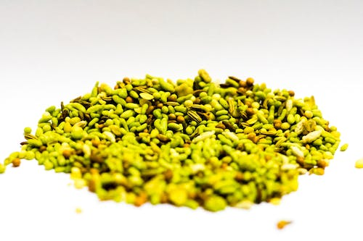
Broccoli seed agreement
I understand that …
1. the program may not have any immediate practical application in my context and that is ok.
2. I do not have to agree with anything presented, but I am happy to see what happens.
3. I may feel uncomfortable, confused and frustrated through this process and I take responsibility for observing and learning from my conscious and unconscious responses/resistances.
4. It is up to me to decide when to push myself further and when to stop and reflect/observe.
(Andreotti et al, 2019 p.24)
Notes:
In our consupmption-driven society, learning is often portrayed as a series of short, sweet bites, like a bag of sweets or candy. We often expect quick, convenient, perfectly tailored bites.
Andreotti and colleagues caution us that while we might want candy, in relation to decolonialty and education we can only offer broccoli seeds- tha will require soil, planting, and caring to result in a possible harvest

Slide 4
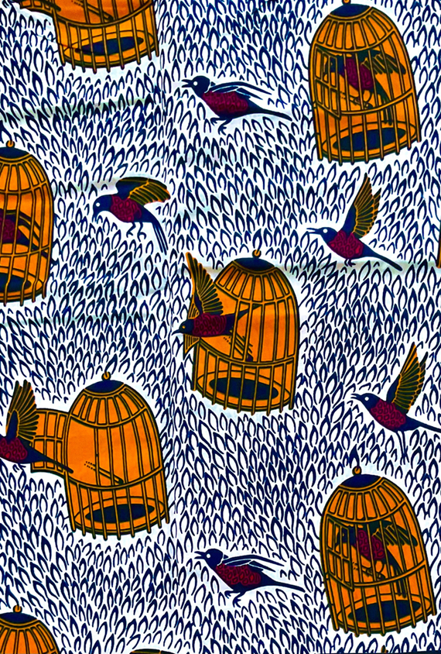
Key terms
Colonisation/Decolonisation
Coloniality/Decoloniality
Notes:
What do you understand the following terms to mean? What are the differences?
Type in the chat – share

Slide 5
Colonisation/decolonisation
To colonize is to settle in, and take control of, land outside your own borders. E.g. the British colonized India for over 200 years. Colonization was motivated by economics. European powers sought to expand their markets and acquire raw materials overseas.
Decolonization is a process by which colonies become independent of the colonizing country. Decolonization occurred in response to independence movements in colonized territories.
(Source: https://www.insightsonindia.com/2022/10/27/colonialism-and-decolonization/)

Slide 6
Coloniality/Decoloniality
“Coloniality (…) refers to long-standing patterns of power that emerged as a result of colonialism, but that define culture, labor, intersubjective relations, and knowledge production well beyond the strict limits of colonial administrations.
Thus, coloniality survives colonialism.
It is maintained alive in books, in the criteria for academic performance, in cultural patterns, in common sense, in the self-image of peoples, in aspirations of self, and so many other aspects of our modern experience.
In a way, as modern subjects we breath coloniality all the time and everyday.”
(Maldonado Torres, 2007 p.243)
Notes:
Maldonado-Torres, N. (2007) ON THE COLONIALITY OF BEING,
Cultural Studies, 21:2-3, 240-270, DOI: 10.1080/09502380601162548
Task – express this in your main language?

Slide 7
Decoloniality
“Decoloniality denotes ways of thinking, knowing, being and doing that began with, but also precede, the colonial enterprise and invasion.
It implies the recognition and undoing of hierarchical structures of race, gender, hetero-patriarchy, and class that continue to control life, knowledge, spirituality, and thought, structures that are clearly intertwined with and constitutive of global capitalism and western modernity. (…)
decoloniality seeks to make visible, open up, and advance radically distinct perspectives and positionalities that displace Western rationality as the only framework and possibility of existence, analysis, and thought.”
Notes:
Mignolo, W.D., and Walsh, C.E. (2018) Decoloniality: Concepts, Analytics, Praxis.
Durham, NC, and London: Duke University Press.
Chapter 1 – need page refereneces for this

Slide 8
Perspectives on sustainability
“It is useful to bring these different perspectives into conversation, and see tensions between these narratives as potentially generative rather than inherently problematic.”
(Tikly, L., 2023) p. 24
Notes:
In the first webinar, we explored the fact that there is no sigle understanding of sustainability, but rather different perspectives or ‚theories of change‘ regarding sustainablity problems, causes and impacts, and possible futures.
In this webinar we are exploring perspectives around decoloniality

Slide 9
Decoloniality and sustainability
Roof
Walls
Foundations
(Andreotti et al, 2019 p.49-50)
Notes:
The foundations of the house are built on a solid concrete that separates humans from the rest of nature, and creates degrees of hierarchical value that rank
these ‘separate’ beings against each other according to their perceived utility (Mika, 2019;
Silva, 2016). These fantasies of separation and hierarchy lay the onto-metaphysical
groundwork for the rest of the house.
The carrying walls of the house are represented, on one side, by tiles of Western humanist values and Enlightenment knowledge traditions, which promise consensus and universal relevance, and which are secured by denying the relevance of non-Western knowledges (Ahenakew, 2016; Santos, 2007; Smith, 2012). On
the other side is the wall of nation-states, which promise security through the mechanisms of borders, rights, and national homogeneity, all of which are ultimately secured through processes of state sanctioned violence ‘at home’ and abroad (Byrd, 2011; Tuck & Yang,
2012).
The roof of this house is made of tiles of global capitalism, layered over beams of continuous economic growth and consumption as a measure of progress and civilization (Coulthard, 2014; Silva, 2007).

Slide 10
Decoloniality and sustainability
“modernity depends on coloniality
for its existence.”
(in Andreotti, 2011 p. 386)
(Andreotti et al, 2019 p.50)
Notes:
Thus, while the house modernity built offers shiny promises, these promises are subsidized by a colonial underside: the externalised and invisibilised costs of building and maintaining the house (see Cartography 2).
This includes historical and on-going expropriation, land-theft, exploitation, destitution, preventable famines, incarceration, dispossession, epistemicides, ecocides, and genocides” (Andreotti et al, 2019 p.49)
“modernity depends on coloniality for its existence.”
Maldonado-Torres, Quijano, Mignolo, Walsh, Andreotti, Stein
(in Andreotti, 2011 p. 386)

Slide 11
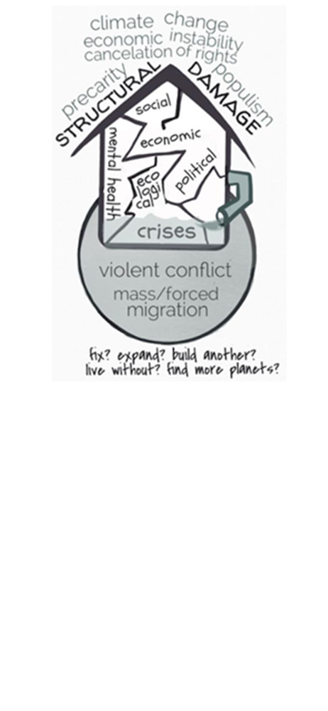
Decoloniality and sustainability
What values, beliefs and practices from the house that modernity built have driven unsustainability?
(Andreotti et al, 2019 p.55)
Notes:
Cracks are beginning to show …
Decoloniality theorists such as Maldonado-Torres, Quijano, Mignolo, Walsh, Andreotti, and Stein draw a direct connection between the assumptions of modernity, or the house that modernity built, and unsustainability.
That is all quite abstract –can you think of particular behaviours, or comon-sense beliefs orr values which brdge the two?
What values, beliefs and practices from the house that modernity built have driven unsustainability?
Identify values beliefs and practices which we take for granted e.g.,
Racism, consumerism, construction of the environment as a resource, free-maret ecmomics

Slide 12
Education and coloniality/decoloniality
“Education systems often reproduce and perpetuate the very conditions that threaten our shared futures- whether discrimination and exclusion or unsustainable lifestyles”
(UNESCO (2021) report from the international commission of the futures of education p.11)
https://docs.google.com/document/d/1_0uUVr8YE1AKmz54m59d9IjHu7LK221OTJBtFjpc9Yc/edit
Notes:
Link to google doc:
https://docs.google.com/document/d/1_0uUVr8YE1AKmz54m59d9IjHu7LK221OTJBtFjpc9Yc/edit
There is a need for „learning opportunities through which people can not only encounter and engage in different intellectual critiques of colonialism, but also develop the intellectual, affective, and relational dispositions that can support them to admit the extentof the problem we face and work through their enduring colonial habits of being.”p.56

Slide 13
Reflection questions
What principles, norms, values and worldviews inform your selection of knowledge for your curriculum? (think about absences as well as presences, centres as well as margins)
Do you articulate your own social and intellectual position, from which you speak?
For whom do you design your curriculum? Who is your ideal, imagined student and what assumptions do you make about their backgrounds, culture, languages and schooling?
How does your teaching recognise and affirm the agency of students of colour? How does your teaching legitimate and respect their experiences and cultures?
How does your curriculum level the playing fields by requiring traditional/ white students to acquire the intellectual and cultural resources to function effectively in a plural society?
How do you build a learning community in your classroom where students learn actively from each other and draw on their own knowledge sources?
How do your assumptions about curriculum knowledge play out in the criteria that you use to assess students? What can you do to make your assessment practices more fair and valid for all students, without inducing high levels of anxiety? What assessment methods could show what all students are capable of, drawing on their strengths and promoting their agency and creativity?
How far do your teaching and assessment methods allow students to feel included without assuming assimilation?
Other?
Adapted from: https://theconversation.com/questions-academics-can-ask-to-decolonise-their-classrooms-103251
Notes:
Invite participants to add ideas and present back

Slide 14
Further resources
Why is my curriculum white?
Antiracist educator toolkit
Global Citizenship Education Otherwise. STUDY GUIDE
Task
Develop one idea for decoloniality in relation to a particular subject, and group of learners – can include curriculum, pedagogy, assessment or something else
Notes:
Link to resources on moodle

Slide 15
Thank you for your participation Next webinar: Dec. 14th 14.50-16.20
Notes:
(Rachel)
Thank you for joining us today. Remember these are activities you might use with your learners – we want your feeback on how you would adapt them, or for smilar activities you have already tried. We will ask you to consider this further in the self-study activities.
The next webinar is on May 15th – see you then!

