Slide 1
Autumn School 2024
Multilingual education and education for sustainable futures
Friedrich-Schiller-Gymnasium, Pirna
27. September- 01. October
Rachel Bowden
TU Dresden

Slide 2
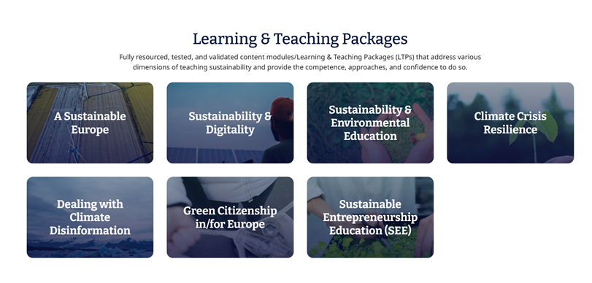
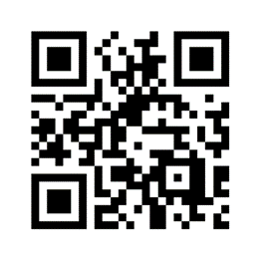
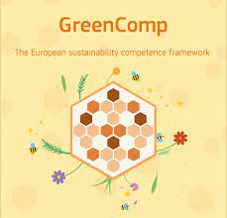
Learning and Teaching Packages (LTPs)
LTP 2.1,
Unit 4

Slide 3
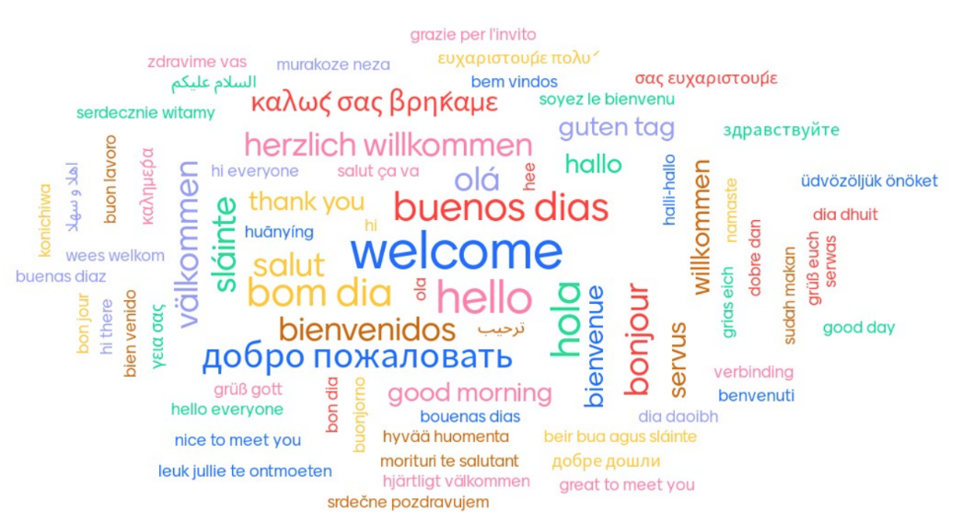

Slide 4
Picture your multilingualism. How do you see it?
Landscape/ Landschaft
Lebewesen/ living thing
Machine
Food or drink
Object / Ding

Slide 5
Metaphors of multilingualism
Language boxes
A dynamic off-road vehicle
A bilingual bicycle
Notes:
Three metaphors for multilingualism, that have been current science at different times. From a view of languages as entirely separate psychologically, to th eview that languages should be separate socially, but are connected at a deeper psychological level. The contemporary view is of multilingualism as a dynamic off-road vehicle, a single holistic system of competences, which speakers use flexibly to adapt to the conditions they are in.

Slide 6
Jigsaw reading
Reflection and discussion
Put your paragraph in order.
List the main points in this paragraph. Use note form or a diagram to show the connections between ideas.
Which ideas here are already familiar?
Which ideas are new to you?
To what extent do you agree or disagree with the arguments presented here? Why?
What further questions do you have?
Notes:
4 groups
The task is to arrange the sentences
Can use a dictionary to check meanings
Discuss points

Slide 7
Monoglossic ideology and standardised language
Monoglossic ideology includes the idea that standard languages such as German, Kiswahili and Greek exist as separate systems of vocabulary, grammar, pronunciation and writing.
This ideology emerged alongside the formation of European nation states and was exported worldwide through European colonisation.
In fact, socio-linguists suggest that standard languages don’t empirically exist, outside of grammar and vocabulary books.
Standardised language is a key human technology, used for sharing ideas across space and time, and the basis of academic disciplines and communities.
At the same time, critical theorists note how the official allocation of standard languages to high status social contexts e.g., education and government, empowers (and disempowers) people depending on their main languages.

Slide 8
Language ideology and research
Monoglossic ideology includes the idea that languages are best separated in social life, and in the brain, for social and psychological unity.
Neurolinguistic researchers have shown that languages are not stored separately in the brain, but are connected as part of a single, holistic psycho-linguistic system.
This suggests that learners who are only able to use part of the linguistic repertoire in education are at a disadvantage, like a drummer playing with one stick.
For socio-linguists, language is human behaviour and includes many forms in addition to verbal language. For example: verbal forms (e.g., written, spoken, standardised, vernacular), paralinguistic cues (e.g., pause, word stress, bold text, font), non-verbal language (e.g., gesture, positioning, movement, dress, layout) and multimodal forms (e.g., pictures, diagrams, photo, video, icons).
Research shows that in real-world communication different language forms (e.g., verbal, non-verbal and multimodal), and different language varieties (e.g., standard languages, dialects, varieties) are often used together as an integrated whole.

Slide 9
Multilingualism in schools: language policy
Most schools in Europe have a single, official language of instruction. Other standard languages, dialects and varieties are not encouraged outside of language classrooms.
This practice benefits learners whose out of school language is closest to the language of education, and disadvantages others, including children from families with lower formal education levels and those from marginalised and multilingual families.
There is a misconception that enabling learners to use familiar languages in school undermines their learning of the official language of instruction.
In fact, enabling learners to use and develop their familiar languages in education is shown to benefit language and subject learning across the curriculum – and this includes learning to use the official language of education.

Slide 10
Multilingual pedagogies
There is no single, simple way to do multilingual education and the use of language in classrooms and in schools should be carefully considered in relation to learners, learning objectives and community goals.
For example, if the focus of an activity is understanding a difficult concept, then allowing learners to explore the concept with familiar language can be helpful.
If the aim of an activity is to teach a particular term or text type, then this should be in focus for all learners.
Although, in both cases discussions about the target form, its uses and comparisons with other forms (e.g., in less formal contexts, or in other standard languages) can help understanding and retention.
A range of pedagogical approaches support language learning and teaching across the curriculum and the use of learners linguistic and cultural resources for learning e.g., genre-based approaches, translanguaging, language supportive pedagogy and culture sensitive pedagogy.

Slide 11
Orientations to multilingualism
Language as a resource
Language as a right
Language as a problem
Ruiz, R. (1984). Orientations in language planning. NABE Journal, 8(2), 15-34.
Notes:
Flip chart paper, write these three headings. Read out the sentences on worksheet 2, in random order. Ask participants to stand by the orientation they think it fits. Short feedback after each one.
Ask participants to think of examples from their own schooling (when they were children or teenagers) and their own experience as teachers and note them on the paper.

Slide 12
Multilingualism is a Problem | Languages are single, standard and separate systems. Monolingualism in a dominant majoritised language is valued Linguistic diversity is a threat to assimilation and national unity Speaking a minoritised language is a communicative disability to be overcome Multilingualism is associated with cognitive difficulties and reduced academic achievement Using and developing minoritized languages undermines learning dominant languages Languages should be separated in school and in society
Multilingualism is a Right | Languages are single, standard and separate systems which we should value equally. Speaking and maintaining your heritage language is a human right Opportunities to learn dominant languages and/or maintain minoritized languages must be provided by schools Languages should be separated at school, in class and at home.
Multilingualism is a Resource | Languages are complex, and holistic phenomena used by people in particular social contexts Linguistic and cultural diversity are an asset for individuals, communities, organisations and professions. Multilingual learners benefit from being able to use their full linguistic repertoires for learning. All learners benefit from explicit language teaching as part of education, including teaching subject specific terms and text types and discussing different forms of expression and meanings. Enabling multimodal communication in school can help all learners participate and achieve

Slide 13
Multilingual Education
Values:
Language as a resource orientation
Learners’ linguistic and cultural resources are valued intrinsically and instrumentally
Knowledge:
Critical awareness of monolingual language ideology and hierarchies between languages and their historical roots (e.g., in colonialism, Euro-centrism)
All learners benefit from using their linguistic resources for learning
Explicit language learning and teaching benefits all students
Practice:
Learners’ languages are visible and audible at school

Slide 14
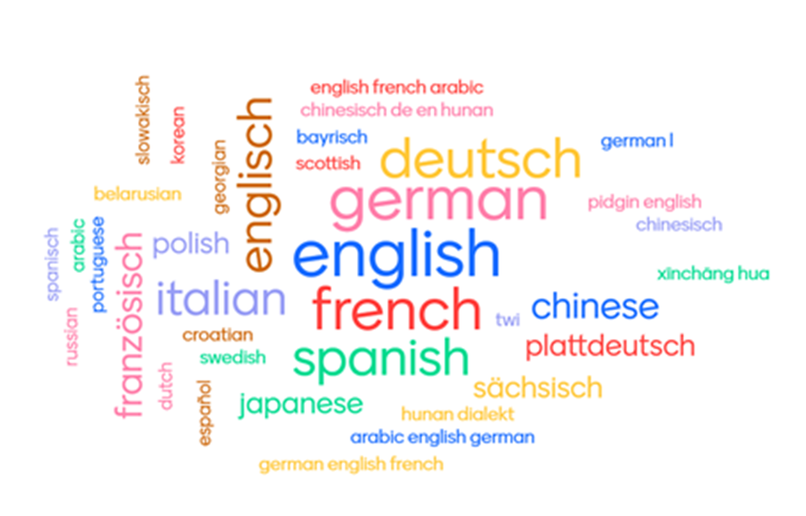
Additional resources: LTP 2.1, unit 4
Multilingual education strategies
Language learning and teaching in subject lessons
A pluriliteracies approach to teaching for learning
Whole school approaches
Translanguaging
Culturally Responsive Pedagogy

Slide 15
What are some connections between multilingual education and education for sustainable futures?

